Slide 1

Need Finding
The process of understanding users, finding requirements, and Analyzing Data

Slide 2
Know Thy Users
I’m a very selfish designer: when I design, I design it for me.
And so
my first task is to become you.

Slide 3
Step into Shoes of the User
You are most probably different from the user
It is not possible that you design a system according to needs of the user
You need to observe the life of the user before you can design a system that would be useful to your user

Slide 4
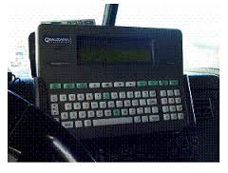
Trucker’s Example
The makers of a GPS system for truckers observed that their system is underutilized
WHY??? What do you think

Slide 5
Trucker’s Example
On closer examination
  Truckers have large fingers
  They wear gloves a lot
HCI experts recommend deep understanding of users

Slide 6
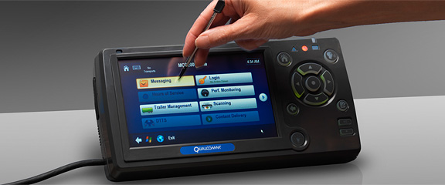
Redesigned :large screen and stylus

Slide 7
Preliminary Research and Analysis
Identify Target Market
Identify user classes
  By going into the users
  By surveying
  By interviewing
  By ethnography

Slide 8
Preliminary Target Market Analysis
Shall be all inclusive, as well as all exclusive
Do not focus on only the “best” or most experienced users
Consider a range of users to ensure that your product works for at least 80% of your user population.
However, it is not impracticable to target 90–95% of the population.

Slide 9
Preliminary Target Market Analysis
Who: Start with questioning yourself about who is going to buy your product. Are they children, teens, millennials, or baby boomers? Are they males or females? Are they service classed or self-employed? What’s their yearly income?
What: What type of products and services do they buy now and what do they expect from it? Does your product fits their requirements?
When: When do they buy the product? Is it daily or rarely? When do they use the product?
Where: Where do they live? Where do they use the product?
Why: Do they buy it because it’s their need, or is it a luxury product for them?

Slide 10
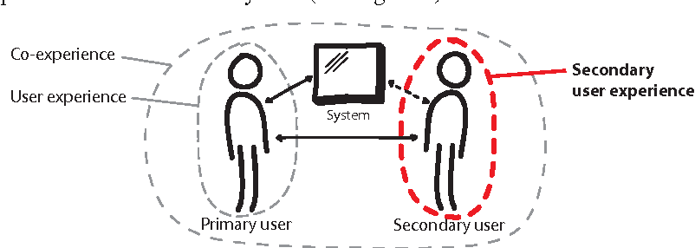
User Classification

Slide 11
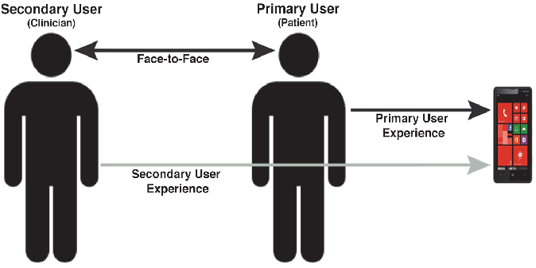
Primary/Secondary Users

Slide 12
Resources
https://medium.theuxblog.com/user-experience-primary-and-secondary-users-in-healthcare-8dd4c5c61490

Slide 13
User Research
Ethnography and Interviewing

Slide 14
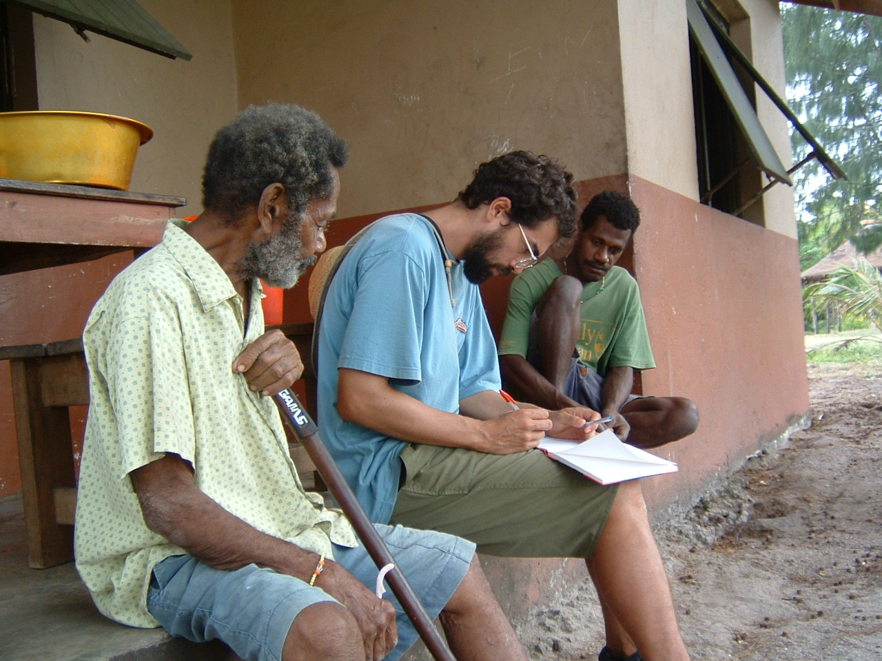
Ethnography
Ethnography is Greek word
  Ethno =folk, people, nation
  Grapho= I write
Systematic description or study of peoples and cultures with their customs, habits, and mutual differences

Slide 15
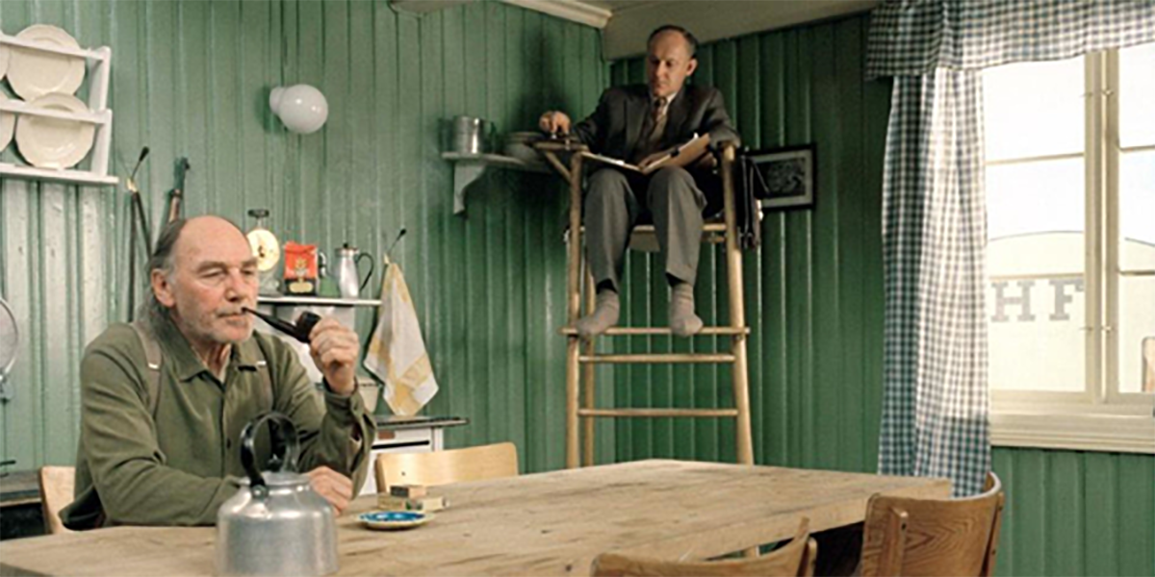
Ethnography

Slide 16
Some points to observe
Who is present?
What is their role?
What is happening?
When does the activity occur?
Where is it happening?
Why is it happening?
How is the activity organized?
What do people do now
What are their goals and motivations
Communication patterns show who talks to whom, and how often. For communication-intensive products, such as telephony, email, or advertising, this information is vital.

Slide 17
Conditions Required
The environment should be the normal working environment.
Ethnography studies a real life scenario as it unfolds.
Permission of the management and users may be required for any or all of this task.
Will need one of the following:
  Notes & still camera
  Audio & still camera
  Video

Slide 18
Limitations
Only successful when accepted by the people in the setting. Reluctance on the part of the subjects results in modified behavior and hence invalid results.
Even though the evaluator tries to remain as unobtrusive as possible their presence may still affect the performance of the observed workers.
The study can be difficult to pin down to a time frame
Analyzing video and data logs can be time-consuming.

Slide 19
Interview Potential Users
You must interview people who are potential users of your system
They can be :
  Current users of a software system:
    The problems they face are potential places to improve
  Not use a software system
    Goal: broaden the number of user
    Try to find out they barriers they see and their goals
Who should you interview if you are redesigning UCP Portal???
Notes:
3 types of user
1 students
2 teachers
3 Management

Slide 20
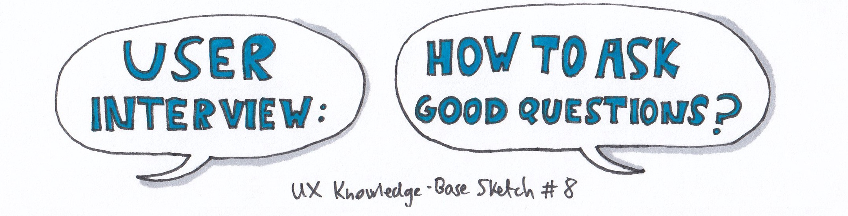
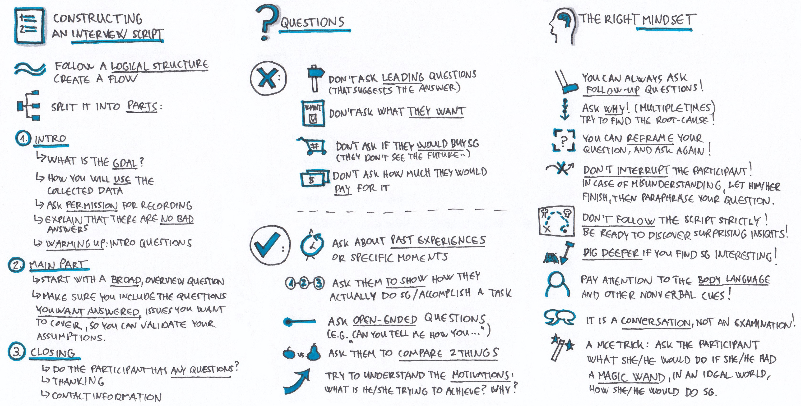
Notes:
when you embark on your user interviews, you’ll want to avoid asking what they want. Asking people what they want will lead you to the wrong insights. You will not discover the root cause of a problem, but rather what they envision as their own ideal solution.
An alternative method is to examine what people do, rather than what they say they do. This approach is based on a simple premise: the best predictor of future behaviour is past behaviour. What people do is a better indicator of the underlying user need than what people say.
3 better questions to ask. And I ask these all the time:
What are you trying to get done? (Gather context)
How do you currently do this? (Analyze workflow)
What could be better about how you do this? (Find opportunities)

Slide 21
Some Tips
Ask Questions neutrally
  “What do you think about shopping “ is better than “don’t you think shopping is great”
Look for inconsistencies
  What people do and what they say are usually different
Watch for the body Language
Don’t ask yes/no questions
  You need stories, even if they are not true. They tell you about how they think about the world

Slide 22
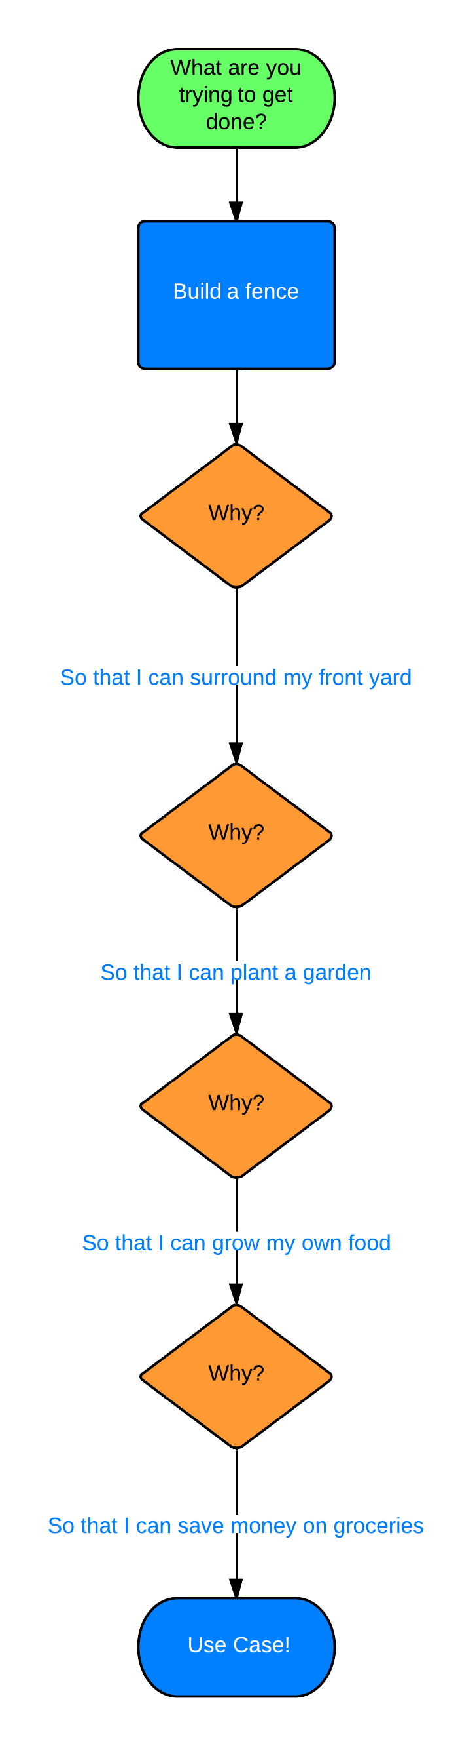

Slide 23
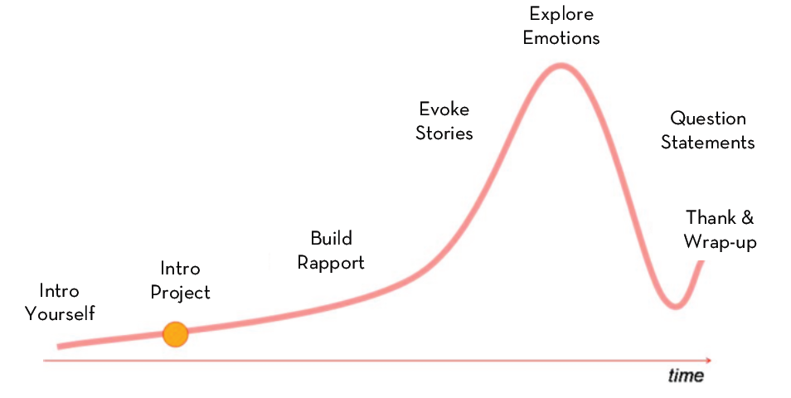
How to Spend Time During an Interview

Slide 24

Recruiting Criteria
Typical user
Non-user
Extreme user
Expert user
Wannabe user
Should-be user
Hater
Loyal to competitor

Slide 25
Assignment
After user Observation and Interviews, submit the following assignment
  User needs
  Photos and captions

Slide 26
Resources
See the “05-Empathy Field Guide.pdf” on Portal
https://medium.com/@userfocus/what-is-design-ethnography-b0a3f8f0339c
https://medium.muz.li/coffee-ethnography-4ee31901286d
https://medium.com/thinking-design/better-understanding-users-through-ethnography-fd6f6395d4

